Slide 1
Power Apps in Microsoft Teams
Module 2
Notes:
Workshop Version: 1.4

Slide 2

Module overview
This module covers the following topics:
 | 1 | Overview of Power Apps in Microsoft Teams
 | 2 | Pre-built app templates
 | 3 | Power Apps basics
 | 4 | Broad app distribution
 | 5 | Hands-on lab: Create an advanced Power App

Slide 3







Overview of Power Apps in Teams
Embedded Power Apps studio in Teams
Simplify work and increase productivity
Easy way to create, edit and publish app within Teams
Build apps based on custom data tables that are Teams-specific and scenario-specific
Ability to share apps with the other team
Notes:
Power Apps in Teams
Simplify work and increase productivity
Make remote work easier and more productive.
Build low-code and no-code applications that can make remote work easier and more productive.
Provides an integrated experience for app makers to create and edit apps and workflows within Teams, and quickly publish and share them for anyone on the team to use, without having to switch between multiple apps and services.
With embedded Power Apps studio, you can quickly build apps based on custom data tables that are Teams-specific and scenario-specific
Access and authorization align with the Microsoft Teams security model and include security groups that enable access for owners, members, and guests of the team that your app is associated with. Ability to assign different security role to Teams Owners and Members
Create apps within Microsoft Teams is available as part of Microsoft 365 subscriptions.
PowerApps in Teams https://docs.microsoft.com/en-us/powerapps/teams/create-apps-overview#:~:text=When%20you%20create%20an%20app%20in%20Teams%20with,and%20share%20team-specific%20data%2C%20apps%2C%20flows%2C%20and%20chatbots.

Slide 4











Pre-built Apps templates in Microsoft Teams
Pre-built apps designed for Teams
Easy to modify to meet specific business needs
Easy to discover in the Teams App store
Available on GitHub
Employee ideas
Inspection
Issue reporting
Bulletins
Milestones
Boards
Perspectives
Profile+
Notes:
Pay attention that the latest apps are not available for one-click installation and are redirecting to GitHub repo.
Using prebuild template:
example to demo of the following starter app
Here are examples of out-of-the-box app templates.
To help organizations realize value faster, you can use templates, which are purpose-built apps for common application patterns that can be easily discovered and installed by members of the team. Although these templates can work without modification, members of the team can customize and extend them to meet the specific needs of their business.
You find more information about these templates and their functionalities is this module’s appendix.
In summary:
Current Available Ones:
Asset Inspection -- Digitize inspection processes. Create checklist style inspections, perform them digitally with the ability to take notes and pictures. Review long term trends on inspection results. Relevant in manufacturing, retail, healthcare, govt, hospitality, transport etc.
Employee Ideas -- Crowd source ideas and prioritization of ideas. Employees can submit ideas in different categories. They can also vote other's ideas. Incident / Issue reporting and management -- Empower the FLW to report issues they see on the ground. Tickets are created in planner. Set SLA for ticket closure, auto assign tickets to right person, track open issues.
Incident / Issue reporting and management -- Empower the FLW to report issues they see on the ground. Tickets are created in planner. Set SLA for ticket closure, auto assign tickets to right person, track open issues.

Slide 5
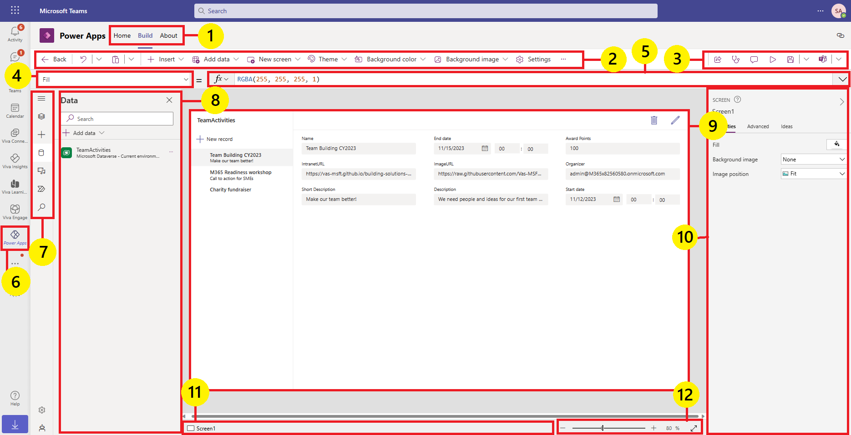
Overview of Power Apps Studio
Build Hub
Power Apps Studio toolbar
App Actions menu
Properties List
Formula bar
Power Apps app
Power authoring menu
App authoring pane
Canvas/Screen
Properties Pane
Screen selector
Change canvas screen size
Microsoft Confidential
Notes:
Demo:
Power App Studio functionality using life demo not slides.
For Power Apps Studio details, slides are included in this module’s Appendix

Slide 6
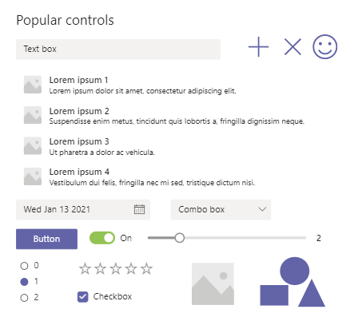
Power Apps basics – Controls
Variety of out-of-box User Interface (UI) elements can be added to screens in Power Apps
These UI elements are called controls
Each control has properties
Microsoft Confidential
Notes:
Instructor to demo controls

Slide 7
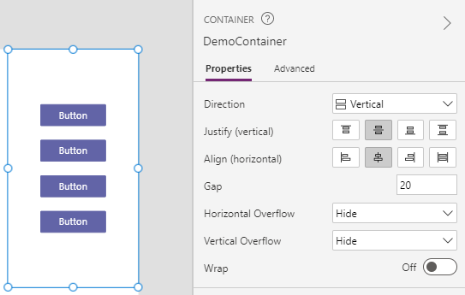
Containers
A container can hold a group of controls
In combination with relative position and width/height of controls, containers enable building of responsive apps
Important: Responsive UI is usually crucial for the apps.
Microsoft Confidential
Notes:
Mention: To save time we will not use containers in Labs but keep responsive UI in mind. You will need to know this to build successful apps.
Important demo:
Show demo of container with items and how responsiveness work;
Add gallery to the screen, explain show position (X/Y) and width/height properties of controls inside
Show how it enables these content to responsive.

Slide 8
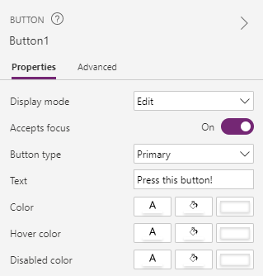
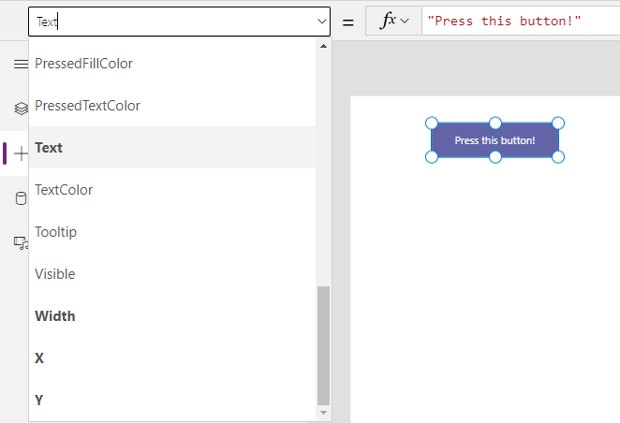
Power Apps basics – Properties
Control property values can be set in two different ways using Properties pane or Formula bar
Properties pane is a user-friendly GUI, where you can quickly modify properties
Formula bar allows to set the same properties but using Power Apps Formula language. It gives more flexibility and allows to create interactive behaviours within app.
Microsoft Confidential
Notes:
Instructor to demo controls properties using life demo

Slide 9
Power Apps Formula Language (PowerFx)
Power Apps has built-in case-sensitive formula language PowerFx
Formulas are applied to controls and are used to:
Calculate property values
Respond to user actions (e.g., user selects a button, or provides other input)
Fill
ColorValue("#201F1E") // select colour by hex code
OnSelect
Set(gblVar, "value"); Navigate('Details Screen') // set gblVar variable as “value” and navigate to Details Screen. ; - is a chaining operator
Notes:
Emphasize that the language is case-sensitive
About PowerFx - Microsoft Power Fx overview - Power Platform | Microsoft Docs
Functions, signals, and enumerations - Power Apps | Microsoft Docs
https://docs.microsoft.com/en-us/powerapps/maker/canvas-apps/formula-reference
Property list and Formula are used together
Allows low code features to achieve functionality within canvas app

Slide 10
Formula examples – Setting property values
Set the Text property for a label
Set the Color property of the label text
Filter the items shown in a gallery
Text
"Hello " & User().FullName
Color
If(ThisItem.Amount < 300, Green, Red)
Items
Filter(Devices, Price > 150)
Microsoft Confidential
Notes:
Functions, signals, and enumerations - Power Apps | Microsoft Docs
https://docs.microsoft.com/en-us/powerapps/maker/canvas-apps/formula-reference
Property list and Formula are used together
Allows low code features to achieve functionality within canvas app

Slide 11
Filtering data
FILTER – filters multiple records by condition(s)
SEARCH – filters multiple records by text matching
LOOKUP – filters a single record by condition(s)
Items
Filter(Devices, Category="Laptops" && Price < 300)
Items
Search(Devices, "ModelName", "ultrabook")
Items
Lookup(Devices, DeviceID = "DVC1000")
Microsoft Confidential
Notes:
Filter, Search, and LookUp functions - Power Apps | Microsoft Docs
Search parameters are, a data source to search, a search text and which column to be search within using the given search text.
source → The data source. search_text → The text to search. column → Column to search the text with in.
Filter: Syntax description:
source →The data set to filter. logical_test → You can specify one or more logical tests separating by them by using commas. All logical tests will bind together with AND operator.
Lookup
The LOOKUP function will return the first record it founds for a given criteria. This function can be used to get a record from your data sourc
source → The data source condition → The conditional expression result → Which column should return. This parameter is optional.

Slide 12
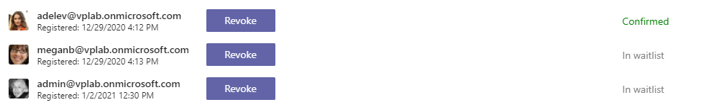
Gallery control
Gallery control displays data from connected data sources
Gallery uses template to display data in repetitive manner
Microsoft Confidential

Slide 13
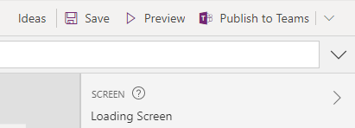
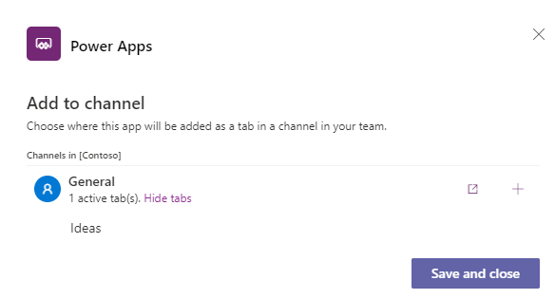
App Actions
Save and Preview your app
Publish the App to a Team of your choice
Manage which channel and name of the tab the App can appear in
Microsoft Confidential
Notes:
App Actions: App Name, Save , Preview, Publish to Teams

Slide 14



Broad app distribution
Contoso Team
After the app is deployed and shared with users outside Contoso team can use the app and benefit from it.
Contoso team users can build and use an app
You can share Power Apps beyond a team
Microsoft Confidential
Notes:
You can now share Dataverse for Teams apps beyond a team | Microsoft Power Apps
Explain that now users can share an app with colleagues outside the team

Slide 15
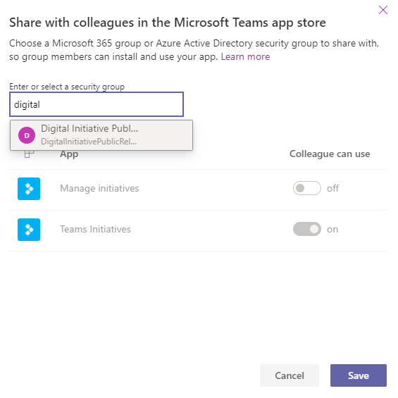
Share apps with colleagues
You can share apps with a security group or a security-enabled Microsoft 365 group
You can share apps to a group with less than 10,000 members
Group members can install and use your app
Microsoft Confidential
Notes:
You can share an app to a single group. You can only share apps to groups with less than 10,000 members.
(The only way currently to share an app with a group outside your team is through a security enabled M365 group. And as of today, the limitation of 10,000 users applies to that security group)
This limit can be increased using the powerPlatform.teamsIntegration.shareWithColleaguesUserLimit
See: https://docs.microsoft.com/en-us/power-platform/admin/list-tenantsettings
Note: Microsoft 365 groups is not security enabled by default. It become security enabled when you add an app to it.
To share an app:
Select Build tab.
Select the team that contains the app you want to share.
In the top-right, select the Share with colleagues.
Search and select the security group you want to share the apps and tables with.
Set Colleague can use toggle to On for the apps and tables that you want to share with the security group selected in the previous step.
6.Select Save.

Slide 16
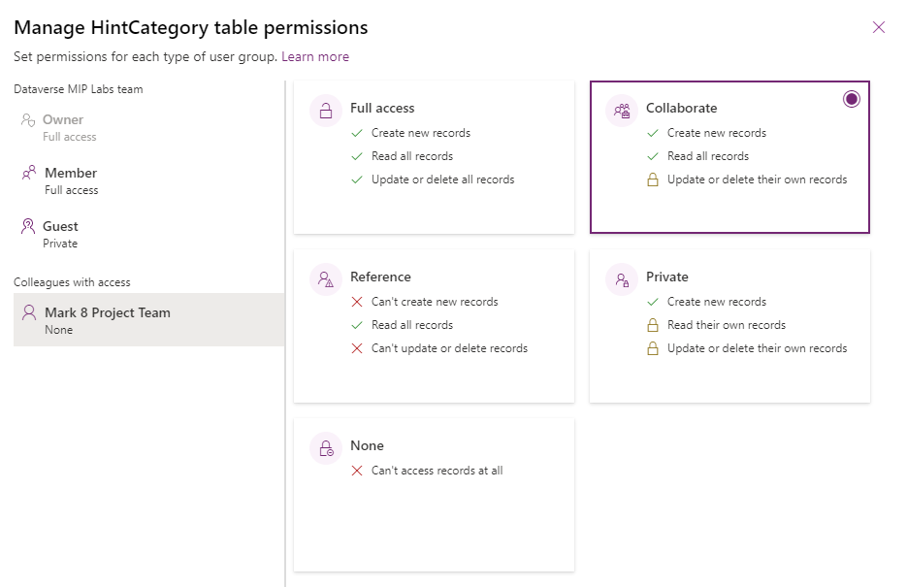
Share apps with colleagues – Table permissions
By default, Colleagues with access role has No access to your Dataverse for Teams tables
With Broad app distribution you can provide users outside your team permissions to access the tables via your app
Microsoft Confidential
Notes:
To share an app with users who are not a member of a team you use Colleague with access
By default, the Colleagues with access role has no access to the data inside any of the custom tables you built using Dataverse for Teams.
If you would like users outside of your team to access this data, you'll need to change the default access to one of these four permission sets:
Full access – Allows end users to see and edit all records in the table.
Collaborate – Allows end users to see all records, but they can only edit their own records.
Reference – Provides a read-only view of data for end users.
Private ­– Allows end users to only view and edit their own data.
Also, you need from the app to select Share with colleagues and enter security group
You can add only one security group with max of 1000 members.

Slide 17
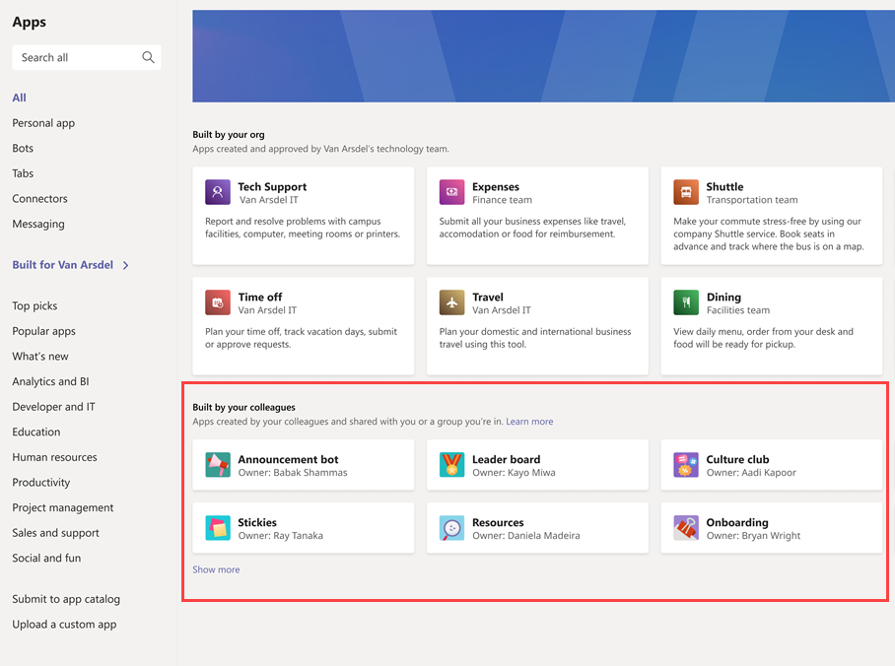
Built By Your Colleagues
Team owners can choose to share apps with other colleagues that don't belong to the development team
Apps appear in the “Built by your colleagues” category in Teams App store
Microsoft Confidential
Notes:
Publish and share your app in Teams
You need to be an owner within the team to share apps and edit table permissions. If you are not an owner, the Manage permission and Share with colleagues options won't appear.
You can share an app and its underlying data with other colleagues within your company that don't belong to your development team.
Apps appear in the “Built by your colleagues” in Teams app store
https://docs.microsoft.com/en-us/powerapps/teams/publish-and-share-apps

Slide 18

Lab 2: Build advanced models and apps
Objectives
Create additional table(s) and tables’ relationships
Set up table permissions
Build Power App from scratch
Publish app to other teams
Never upload your organization data to the lab tenant.
Notes:
Refer to lab 1-0 instructions
##########

Slide 19
Appendix

Slide 20
Formula Language – Locale settings
Some separators and operators will shift based on the author’s locale settings:
Author's language decimal separator | Power Apps decimal separator | Power Apps list separator | Power Apps chaining operator
. (dot or period) | . (dot or period) | , (comma) | ; (semi-colon)
, (comma) | , (comma) | ; (semi-colon) | ;; (double semi-colon)
For example, a formula in locale, where a dot is a decimal separator:
OnSelect
Set(gblVar, 3.1415); Navigate('Details Screen')
The same formula in locale, where a comma is a decimal separator:
OnSelect
Set(gblVar; 3,1415);; Navigate('Details Screen')
Notes:
Global canvas apps - Build global support into canvas apps - Power Apps | Microsoft Docs
Operators in Power Apps - Operators and Identifiers - Power Apps | Microsoft Docs
Lab guides have appendices with localized formulas

Slide 21
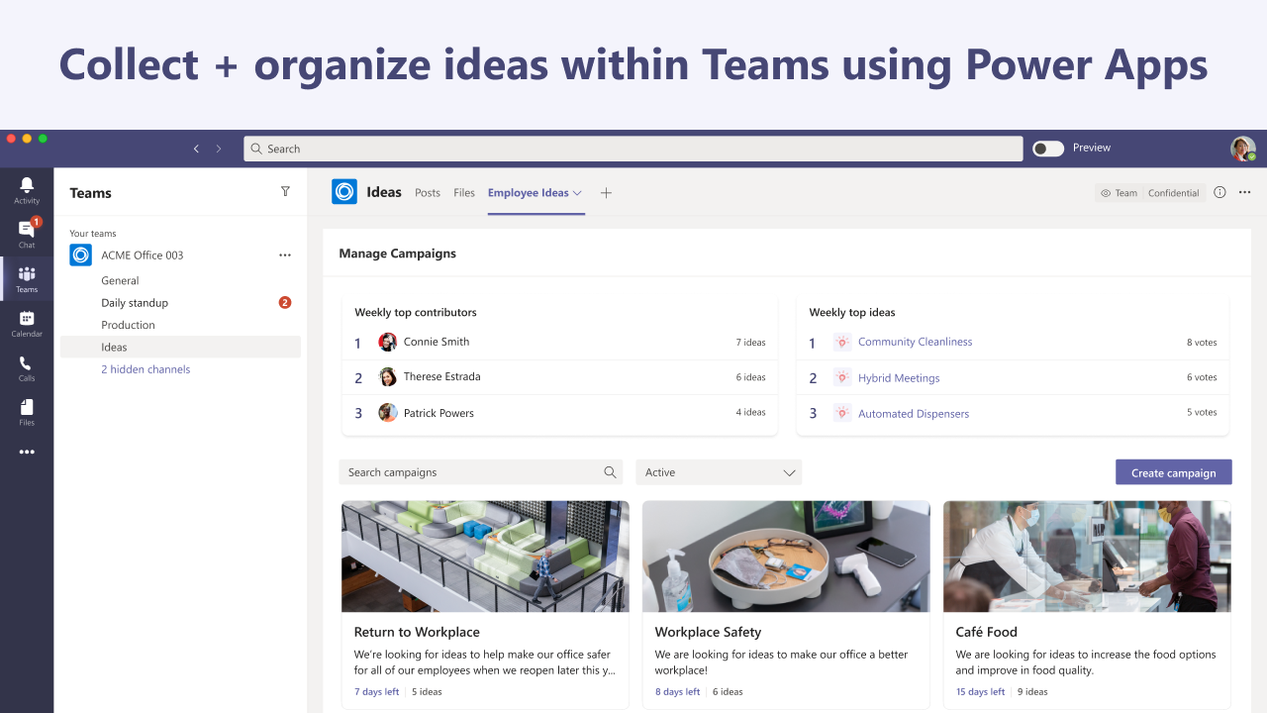
Employee Ideas
Enables team members to quickly generate and organize ideas
Easily review, manage, and act upon team's ideas
Help managers to improve workplace with employees' ideas
Microsoft Confidential

Slide 22
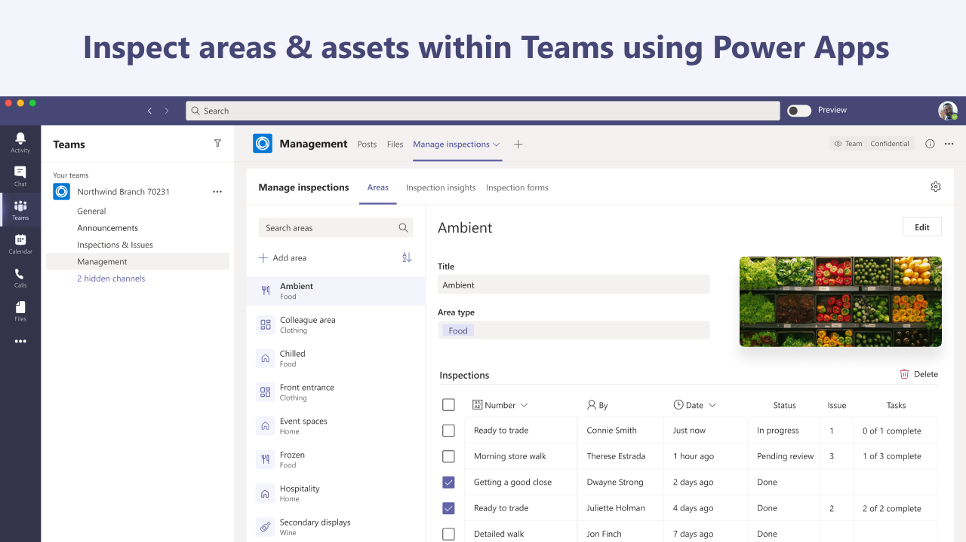
Inspection
Create customized checklist style inspections for area and assets
Ability to take notes and pictures
Issues identified can have tasks created right from the app
Microsoft Confidential

Slide 23
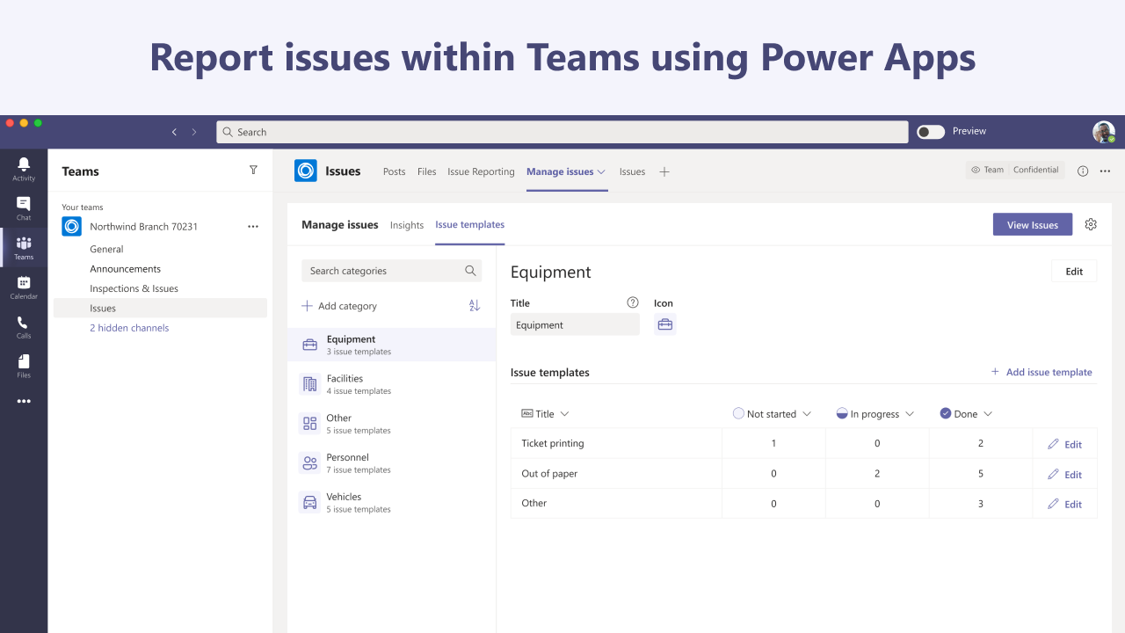
Issue reporting
Empower the front-line worker to report issues
Easily collect issues submitted in Planner for effective case management within Teams
Microsoft Confidential
Notes:
Empower the front line worker to report issues they see on the ground.
Easily collect issues submitted in Planner for effective case management within Teams.
Define issue templates with SLA for task closure, auto assign tickets to right person, and track open issues based on a customizable template.

Slide 24
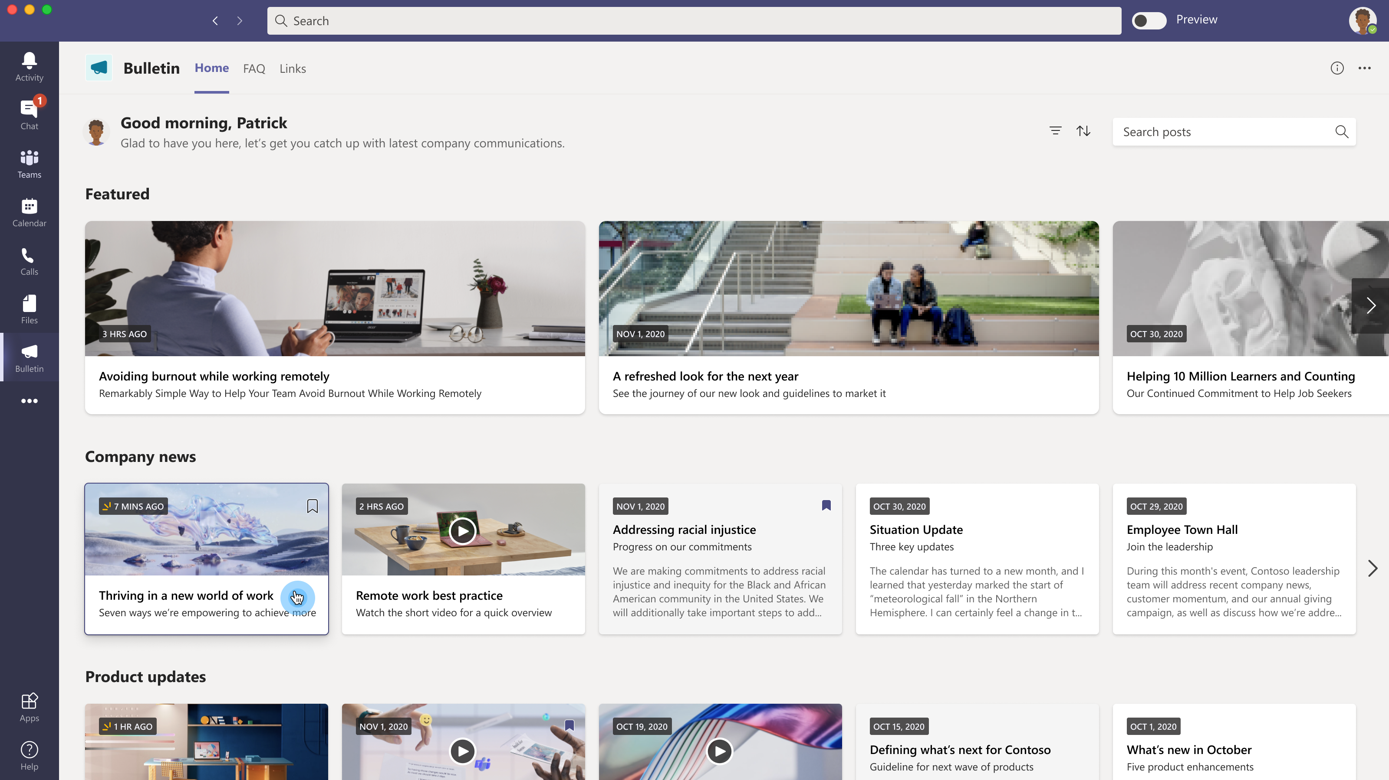
Bulletins
Manage company or departmental communications in Teams
Notify employees of most critical information via 1:1 bot messages
Get information on communication open rates and bookmark rates
A central location for internal communications and resources
Microsoft Confidential
Notes:
Read all company communication post in a central place:
View all company communications, broadcasts, and announcements
Customize post categories
View company wide important FAQ and links to get your answers quickly..

Slide 25
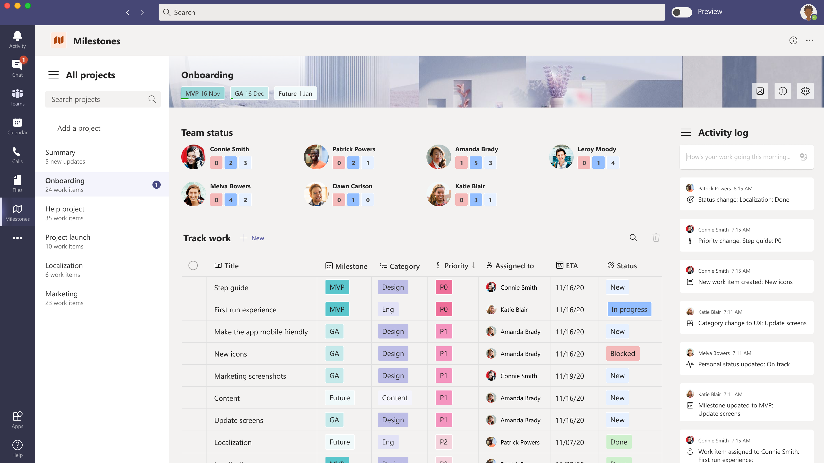
Milestones
Teams can track progress of work against critical milestones
Collaborate on key updates via daily activity log
Customize the app to track the most important information
Manage projects effectively by phasing efforts around key milestones
Microsoft Confidential
Notes:
Stay on top of your work with efficient tracking, team status, and activity log:
Plan, track, and prioritize team's work capacity across projects in a central place
Check team status and work item updates
Easily manage several projects in the app to avoid switching platforms

Slide 26
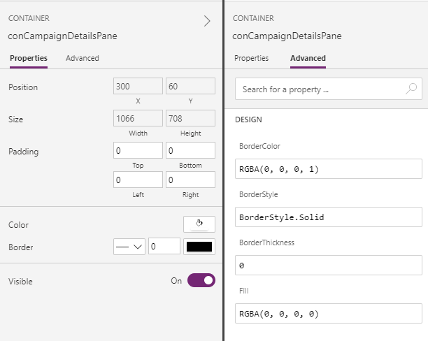
Properties Pane
Set controls’ property values
Properties pane shows popular generic properties such as alignment, colour, size, and position
Advanced tab shows additional options for advanced customization
Microsoft Confidential
Notes:
The properties pane shows properties and options available for the currently selected object on the canvas. The Properties tab shows generic options such as the name, color, size, or position.
The Advanced tab shows additional options for advanced customization. The advanced properties might sometimes be locked for editing, such as when working with data cards.

Slide 27
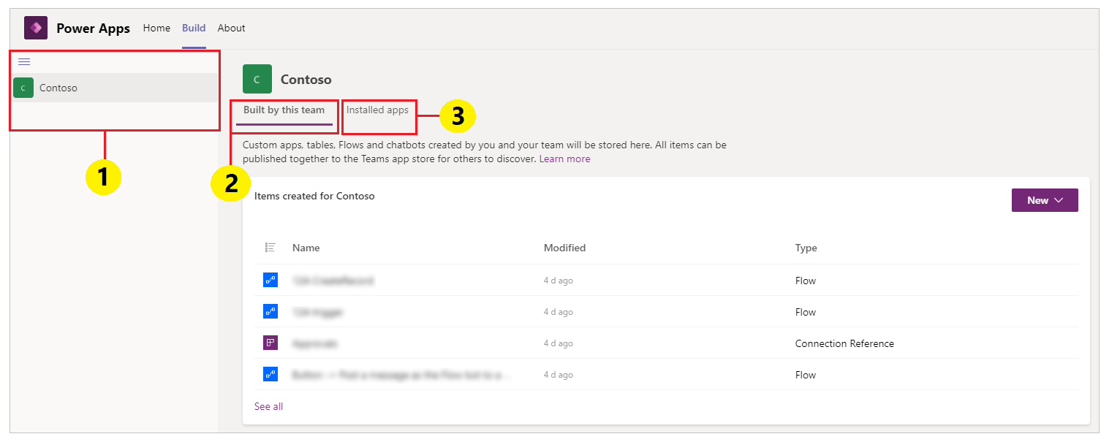
Build Hub
Create an app
Access to App templates
Access to Canvas App and tables you built
Check the installed Apps
Microsoft Confidential
Notes:
Slides Note:
The Home, Build, and About tabs
To demo Build hub click on Build. Opening Power Apps Studio from the build hub opens an app authoring experience that inherits the Teams interface and options.
1. Environments: Each Microsoft Teams team with an environment that you have access to is listed here.
If you have more than one team with environments created, select the team or environment you want from the left pane.
2. Built by this team: This list shows all Power Apps objects such as apps, flows, and tables created in the selected environment (the Teams team). Select New app to create a new app. Select See all to open the solution explorer for the environment.
3. Installed apps: Shows a list of installed apps in the environment (Teams team) from the Teams app store.

Slide 28
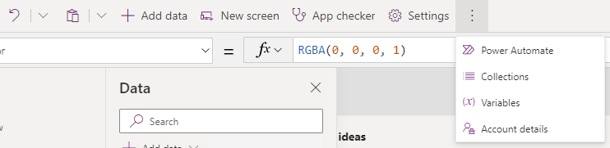
Power Apps Studio toolbar
Undo and Redo
Cut and paste
Add Data
New screens
App Checker
Settings
Collections
Variables
Account Details
Microsoft Confidential
Notes:
Go through all toolbar buttons via a demo with attendees.

Slide 29
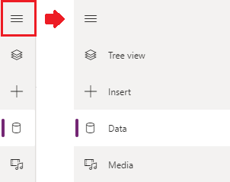
App Authoring menu and options
Navigate app structure using Tree view
Insert controls to the screens in Insert pane
Utilize Dataverse for Teams tables and Connectors using Data sources pane
Upload images, videos, and audio files to static app Media resources
Microsoft Confidential
Notes:
Tree view, Insert, Data sources, or Media.

Slide 30
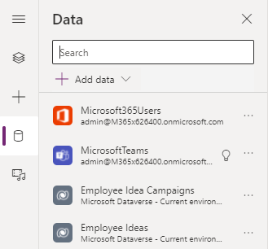
Data Sources Pane
Add tables from Dataverse for Teams
Access to Connectors
Microsoft Confidential

Slide 31
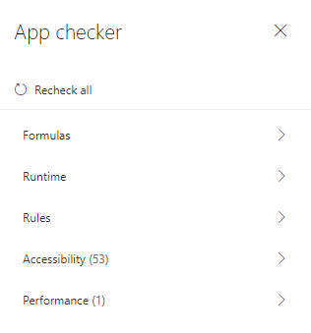
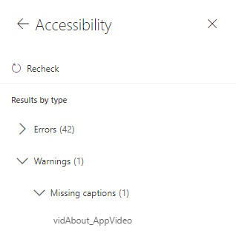
App Checker
Helps to resolve formula issues
Runtime issues
App Accessibility
Microsoft Confidential

Slide 32
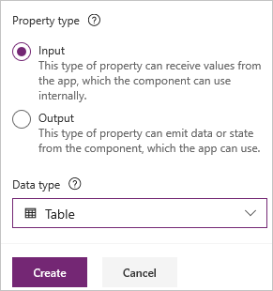
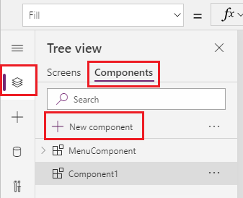
Components
Components are reusable building blocks for canvas apps
Use custom properties to receive input values and emit data
Create component libraries
Can be created using code (PCF)
Microsoft Confidential
Notes:
Components can use advanced features such as custom properties and enable complex capabilities. This article introduces component concepts and some examples.
PCF Components can also be created using custom code: What are code components? - Power Apps | Microsoft Docs

Slide 33
Variables and collections
SET – sets global variable, that can be reused later anywhere in the app
UPDATECONTEXT – sets local variable, that can be reused on the current screen
COLLECT – adds records to the collection
OnEvent
Set(gblVar, "value")
OnEvent
UpdateContext({ Name: "Lily", Score: 10 })
OnEvent
Collect(IceCream,{ Flavor: "Strawberry", Quantity: 300 })
Notes:
Understand variables in canvas apps - Power Apps | Microsoft Docs

Slide 34
Questions?

